Slide 1

Public Bicycle Query System
Reinforced by Semantic Web
Jiawei XU Malshani R.G

Slide 2
Introduction: Problems
Many kinds of open data have been published in web sites
Bicycle sharing stations
Bus, tram, train and car system
Problems:
Data published in specific websites: government’s website...
Not use same format for the data
An integrated public bicycle sharing system is need in many domains: Travel, Work, Joy...

Slide 3
Introduction: Solution
Intermediate outputs:
Domain Ontology
Application to extract open data from web sites
Model for represent the data of bicycle sharing stations
Website for query information of stations
Final output (yet and still working):
Website to search available bicycles at bicycle stations
Combine other transport data, even weather and price detail
Provide a trip planning solution: closest or has most available bikes
Notes:
We gonna explain how we reach to solution using semantic web technologies

Slide 4







System Architecture

Slide 5
Concerns
For now
We take three cities
Different concepts
Different key value pairs
Design our own ontology:
Not validated by domain experts

Slide 6
Implementation
Static pages
Create
Data Set
Update
Store Data
Develop the ontology in Protege
Extract Static Data
Create the Model by generating RDF Triplets
Extract Dynamic Data
Update the Model
Apache Jena
SPARQL, FUESKI
Create Website and REST API to visualize the data
Use SpringBoot, Maven, AJAX, BootStrap
Add RDFa to HTML
Apache Jena
SPARQL, FUESKI
Dynamic pages
Website

Slide 7
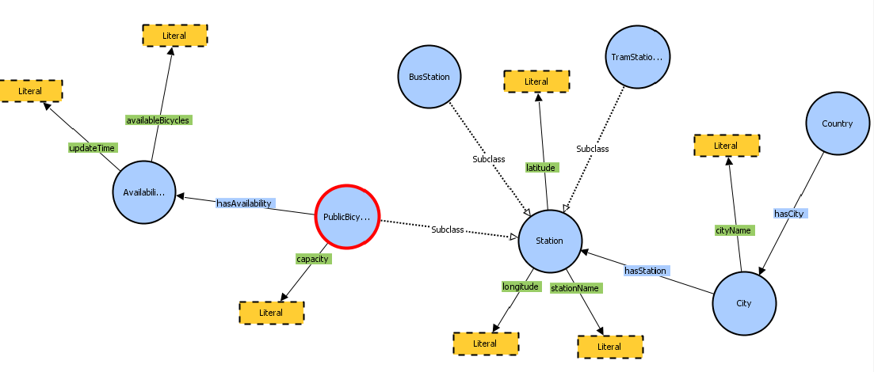
Stations Ontology

Slide 8
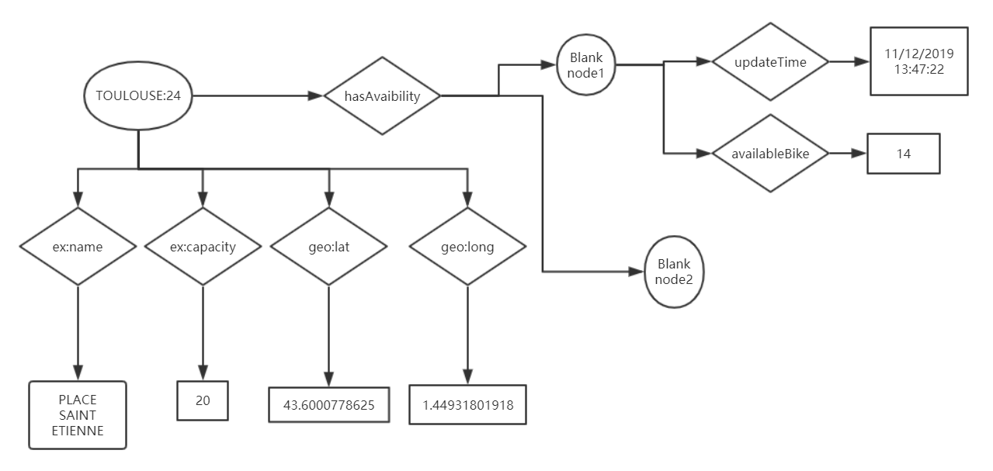
Simple RDFs Example of a Station

Slide 9
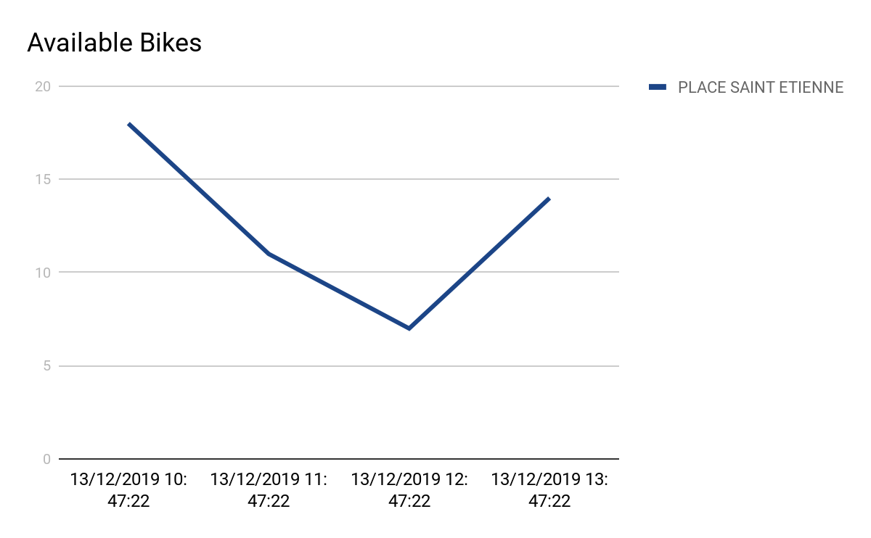
Statistics: Historical Data of Stations
Statistics graph based on dynamic data of stations is interested by public bicycle sharing company. For example: transfer some bicycles to meet the need of Business zone of a city.

Slide 10
Vertical Comparison
Something about database and query with/without semantic web: RDFa, RDFs, Apache Jena

Slide 11
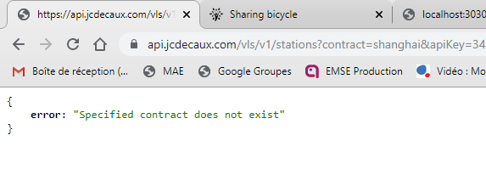
Horizontal Comparison
Easily extensible to new city and meet different data formats of cities’ public bicycle sharing website.
More stable to face change of data format compare with get data from JCDecaux API. In fact, a good solution should has both ways to get data.

Slide 12
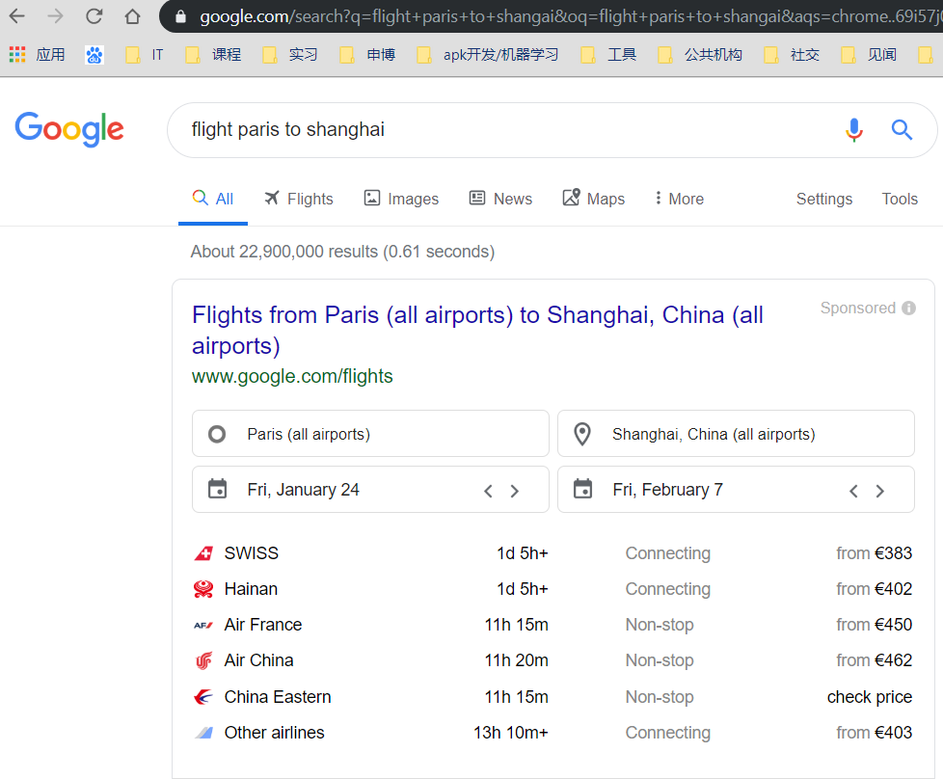
Future works
This is our First Prototype, then:
Refactor the Model
Add more properties
Add more descriptions
Refactor the code
Optimize the queries
Add more cities
Good usage of RDFa

Slide 13
THANK YOU!

